Slide 1
Steering Meeting 7
Week 50 Group 1
Notes:
W5

Slide 2
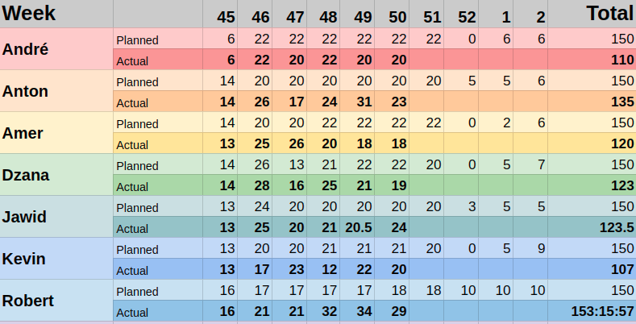
Time Tracking

Slide 3
18 tasks
were done during week fifty

Slide 4
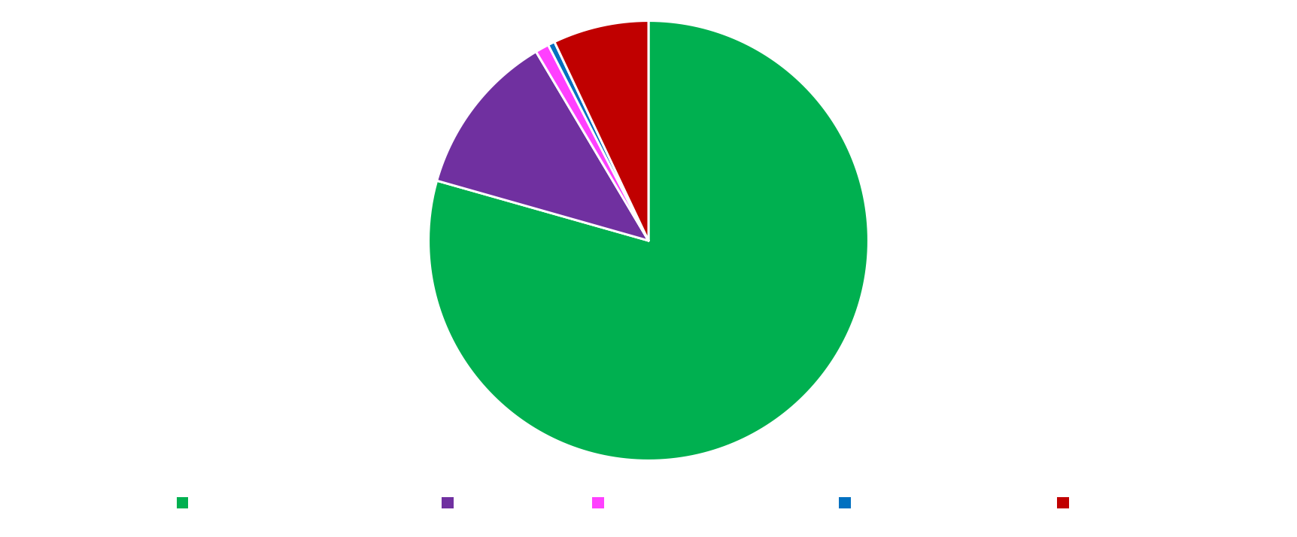
Previous Week (W5)
79 hours 12 hours 1 hours 0.5 hours 7 hours

Slide 5
Week 50 Short Summary
Pulling artifacts from Teamforge
Handling of board data after board update request
Button for sorting categories/swimlanes now it’s working
Created the admin filter dashboard, view to select project.
Kanban card GUI, model and board design.
Display more sense data
Fixing minor bugs
Parent categories

Slide 6
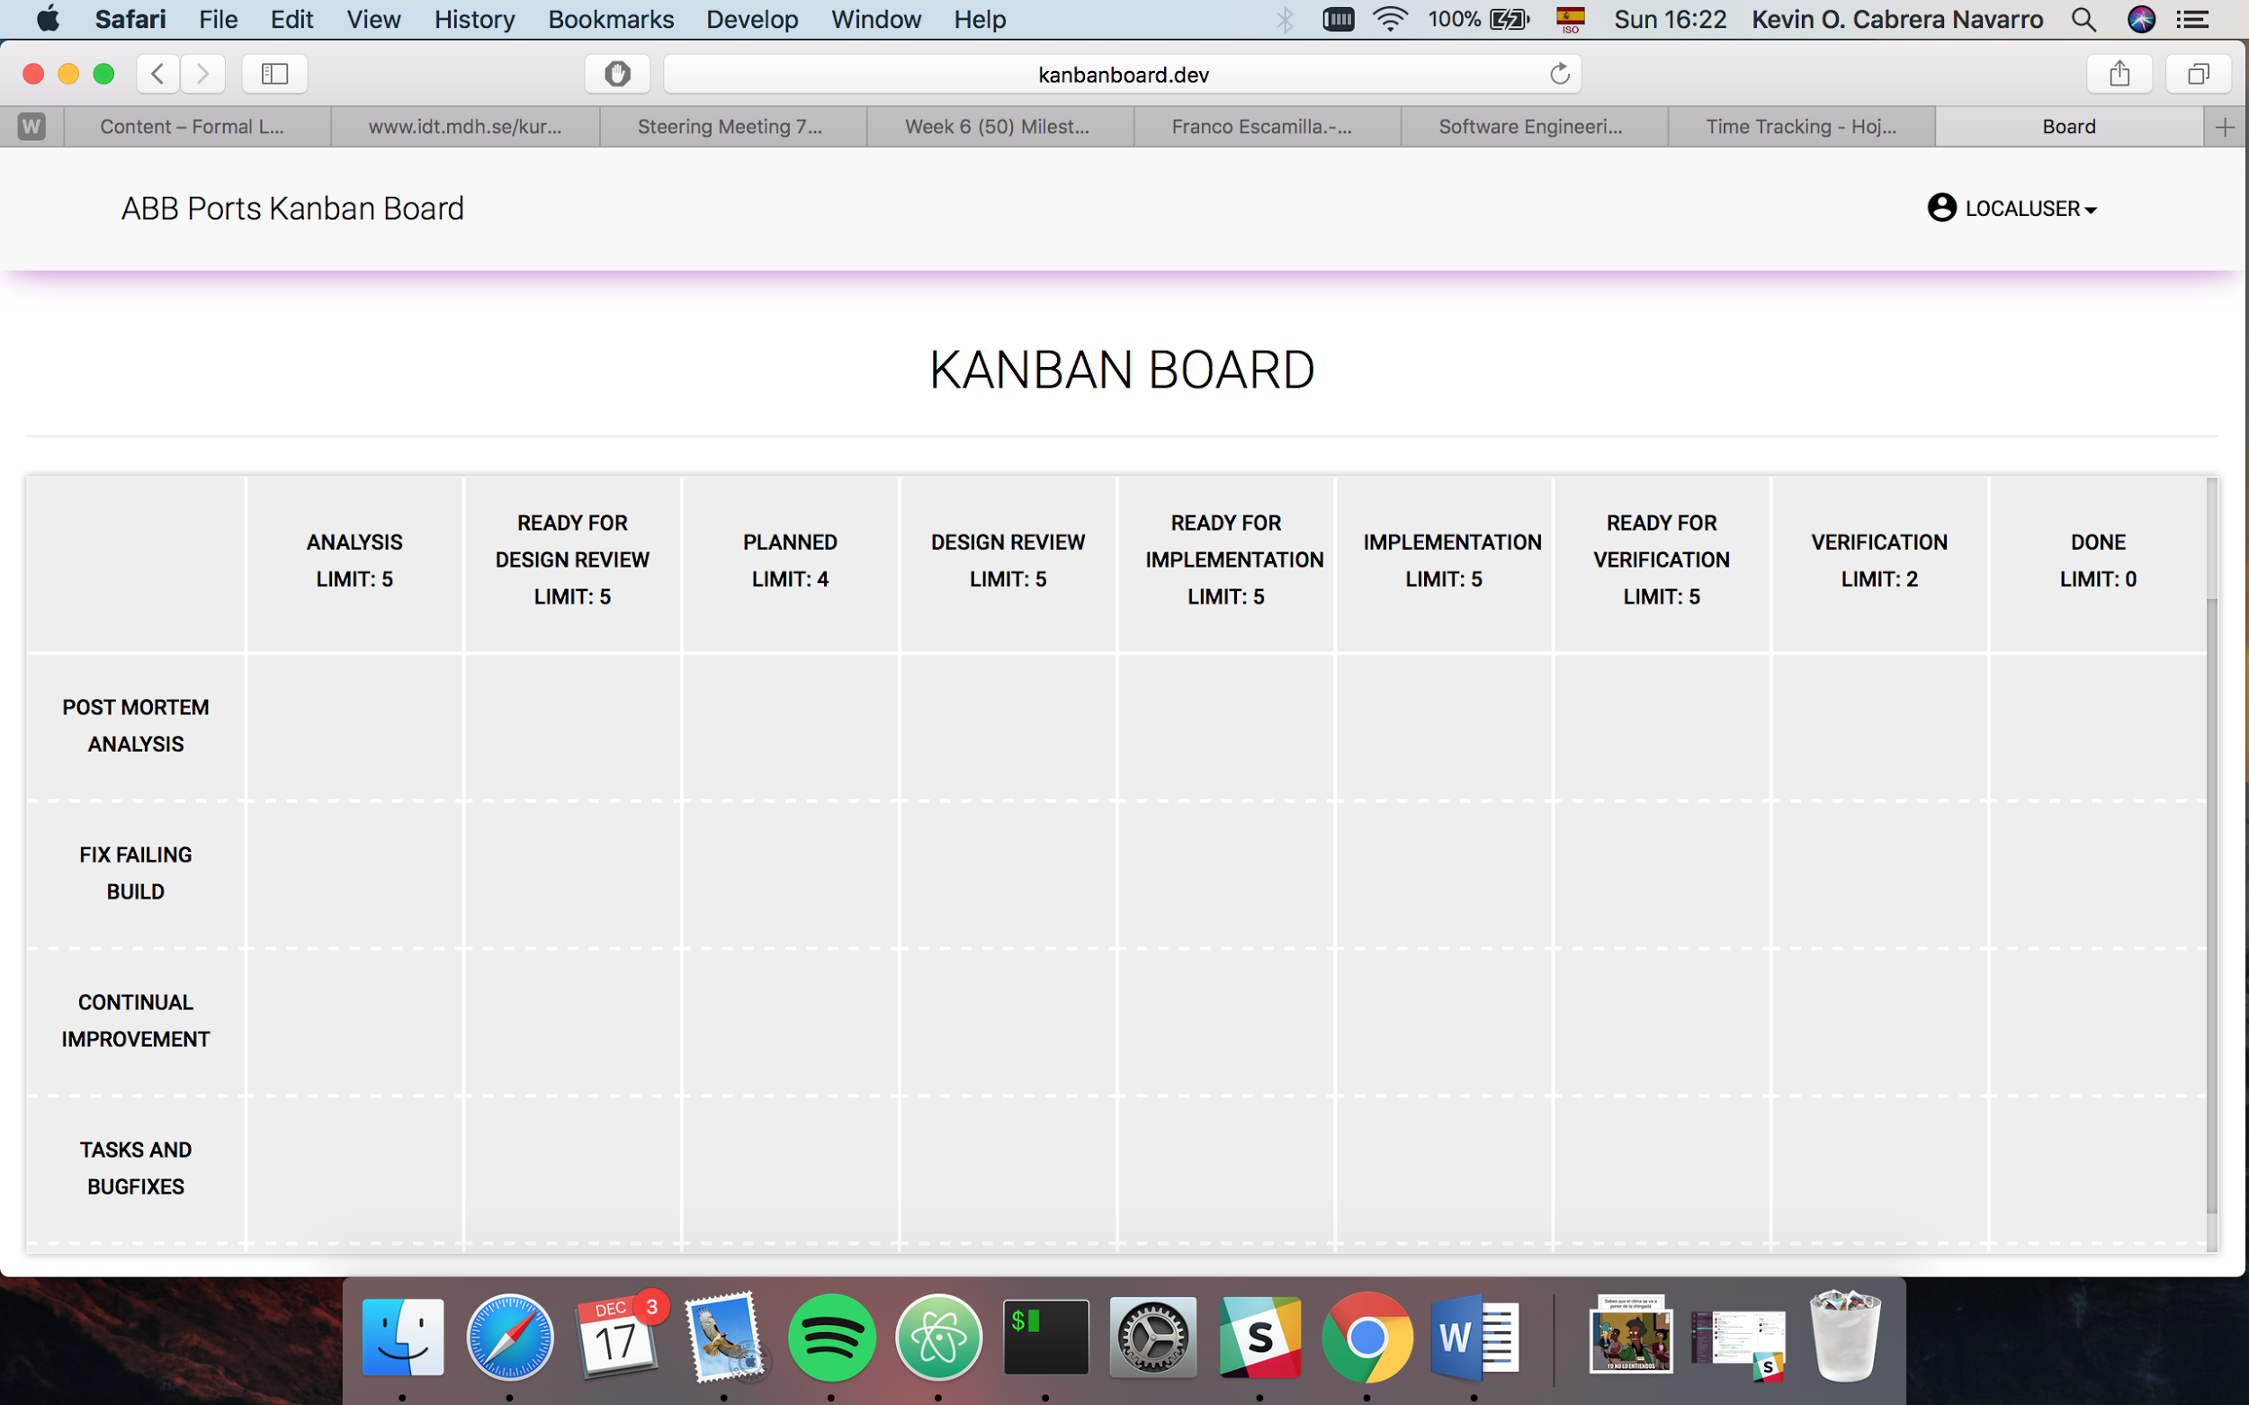
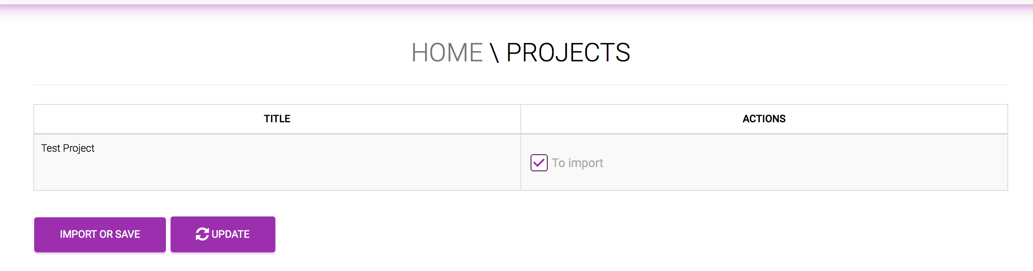
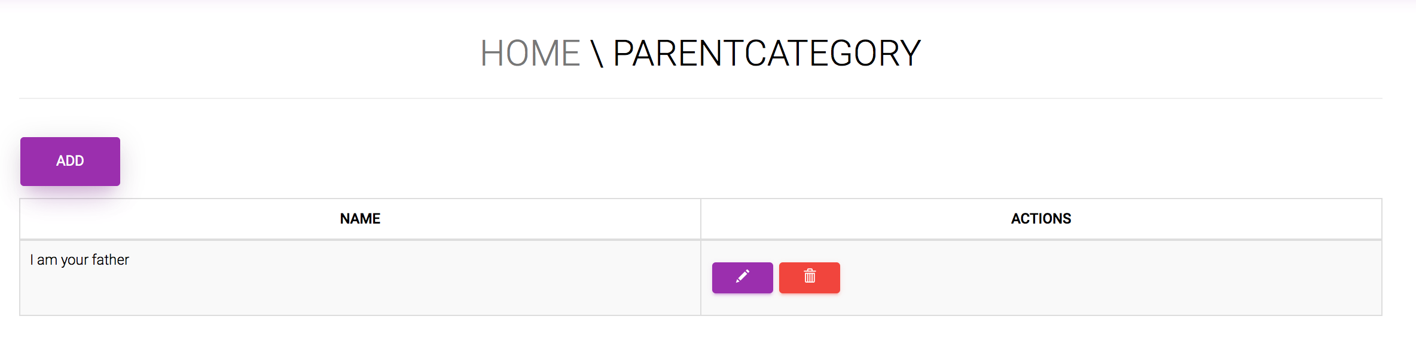

Slide 7
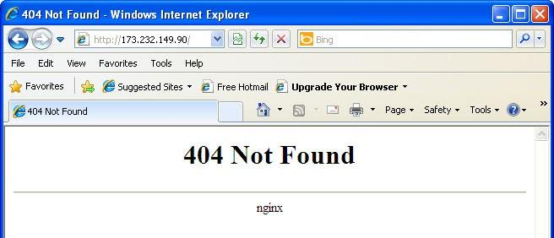
Previous Week (W6)
Open

Slide 8
Next Week

Slide 9
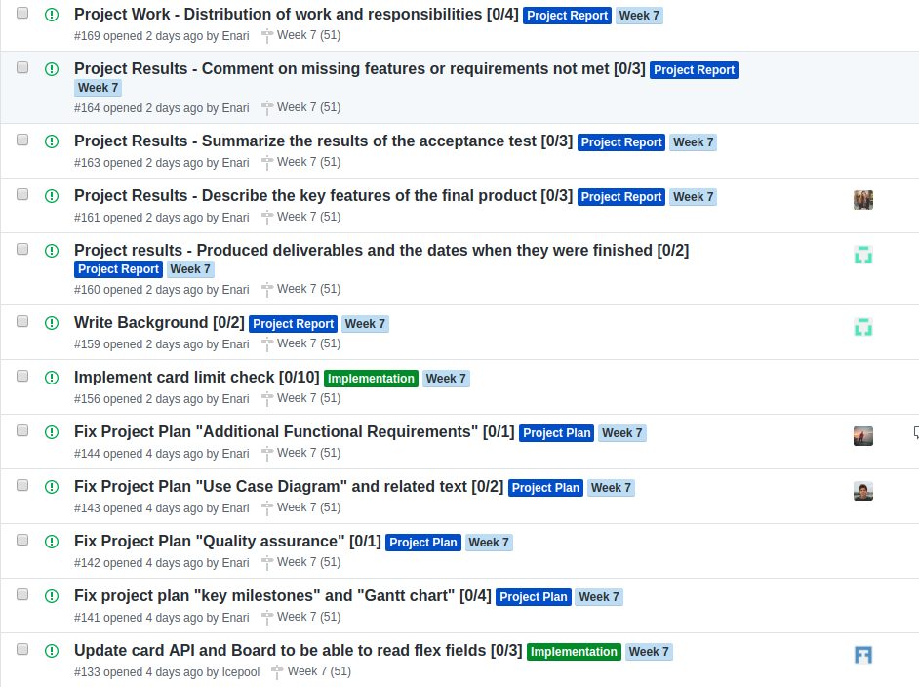
Next Week's Issues

Slide 10
_Implementation_
2 issues 13 hours
Project Report Project Plan .
7 issues 4 issues 20 hours 8 hours

Slide 11
Questions for us?
Notes:
Taco night on friday

Slide 12
GOD JUL OCH NYTT ÅR! :)

